Slide 1
Story board
CrashAlert
Enhancing Peripheral Alertness for Eyes-Busy Interaction while Walking

Slide 2
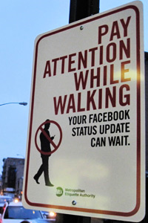

Eyes-busy interaction, such as text-entry while walking can be dangerous and life-threatening
[show some images like these]

Slide 3
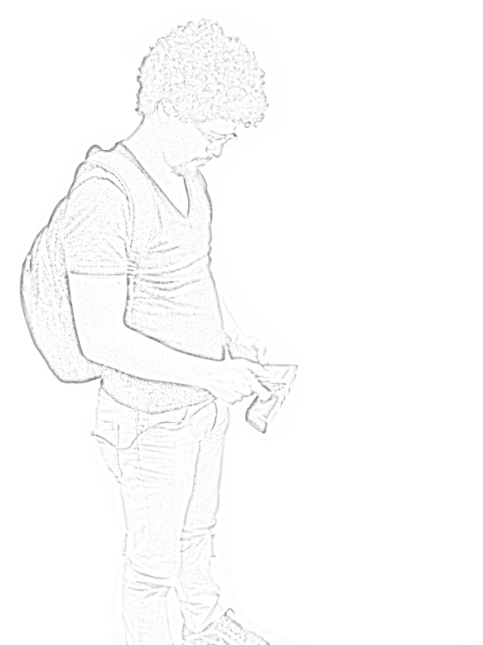
When people walk and multi-task much of their field-of-view attends to the display.
This has motivated eyes-free interaction but also warrants investigation into methods for assisting with eyes-busy interaction while walking.
[show the image below but piece by piece]
Transformed Depth Slice Image
Camera FoV
Depth Slice
User FoV

Slide 4




We introduce CrashAlert
CrashAlert brings peripheral content from environment into the user’s field-of-view, on the mobile device
[Show the Ambient Band]

Slide 5
We process information from a depth camera attached to the mobile device [show image] to show relevant bits of information
[show a person walking, and screen capture of the laptop]

Slide 6
Our results show that users feel safer with CrashAlert, do not require lifting their heads as much from the task and ....
Their performance on the task is also not affected by using the ambient display
[shows some graphs]

Slide 9
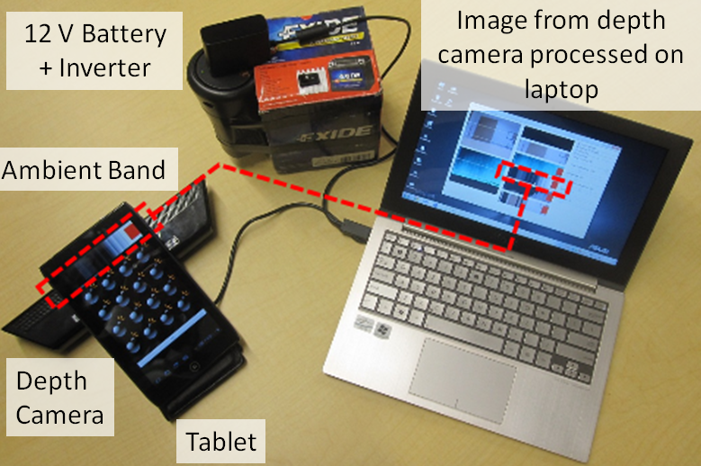
Transformed Depth Slice Image on Ambient Band
Camera FoV
Depth Slice
User FoV

Slide 14
Black
Color
Depth
Mask

Slide 15
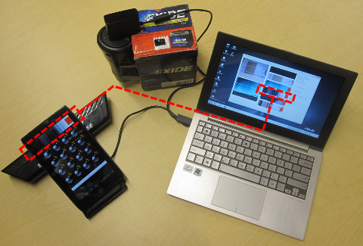
Image from depth camera processed on laptop
12 V Battery + Inverter
Ambient Band
Depth
Camera
Tablet

Slide 16
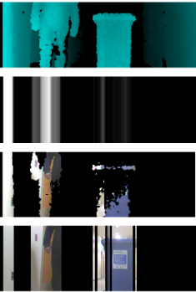
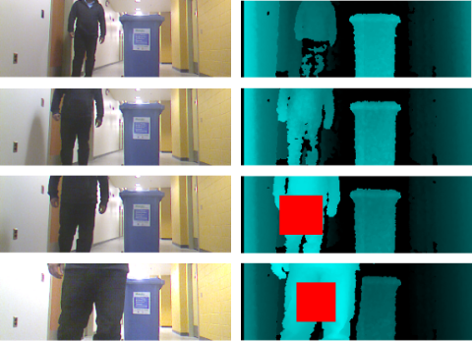
a
b
c
d

Slide 17
Safety
Efficiency
Alertness

Slide 18
Safety
Walk Faster
Black
Color
Depth
Mask
Notes:
Black

